Slide 1

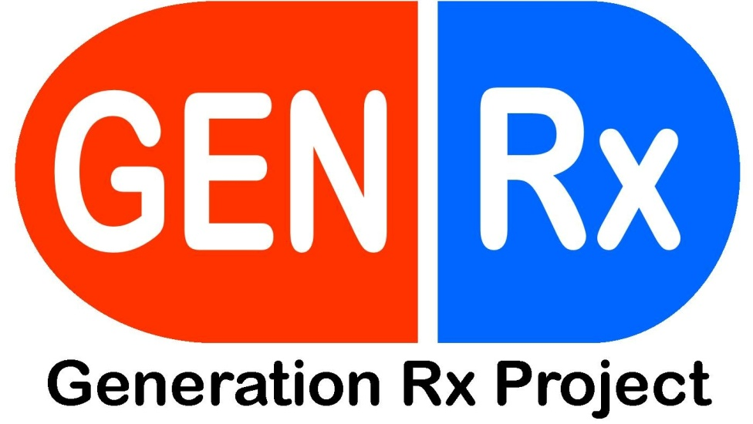

Slide 2
DBHDD launched this project in October 2012
Implemented in 3 counties: Catoosa, Early, and Gwinnett
Goal: To reduce Rx drug misuse and abuse among 12-25 year olds within target communities.

Slide 3
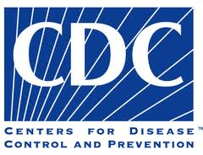
Why Launch GEN Rx in GA?
CDC has classified Rx drug abuse as an EPIDEMIC

Slide 4
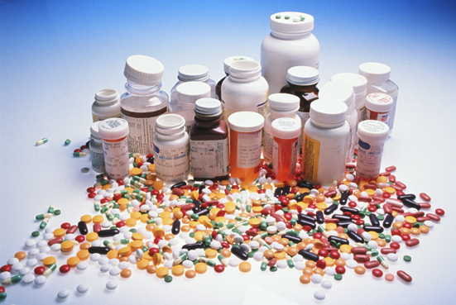
Why Launch GEN Rx in GA?
Rx drugs are abused more than cocaine, heroin, ecstasy and meth combined.

Slide 5
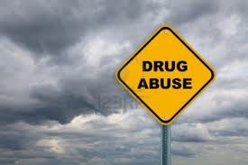
Abuse vs. Misuse

Slide 6
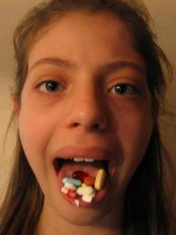
Prescription Drug “Misuse”
Definition:
  the use of prescription drugs without a prescription or use that occurred simply for the experience or feeling the drug caused.

Slide 7
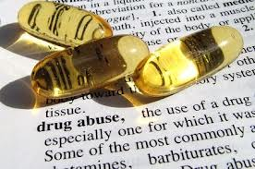
Prescription Drug “Abuse”
Definition:
  When someone takes a prescription drug that was prescribed for someone else in a manner or dosage other than what was prescribed.

Slide 8
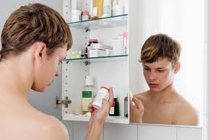
Key Indicators of Abuse
Taken without a prescription
Taken in a way other than as prescribed
Taken for the “high” elicited
Taking a friend's or relative's prescription to treat pain or because you think it will help with studying.

Slide 9
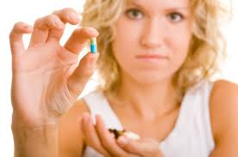
Teen Use
Every day in the US, an average of 2,000 teenagers use prescription drugs for the 1st time without a doctor's guidance.
Among youth who are 12 to 17 years old, 2.8 percent reported past-month nonmedical use of prescription medications.

Slide 10
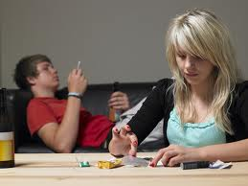
Teen Use
According to the 2012 Monitoring the Future survey, prescription and over-the-counter drugs are among the most commonly abused drugs by 12th graders, after alcohol, marijuana, synthetic marijuana and tobacco.

Slide 11
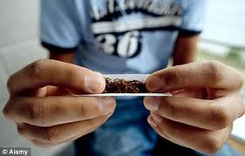
Teen Use
Youth who abuse prescription medications are also more likely to report use of other drugs.

Slide 12

Teen Use
1 in 5 young adults has abused a Rx drug
1 in 10 youth ages 12-17 has abused OTC cough medicine to get high

Slide 13

Top Reasons for Abuse
To get high
To treat pain
To help with school work

Slide 14
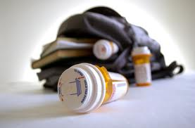
Access
51 % of high school seniors said opioid drugs other than heroin are fairly easy or very easy to get
Over 70% of people who abused Rx pain relievers got them from friends or relatives
5 % got them from a drug dealer or the Internet

Slide 15
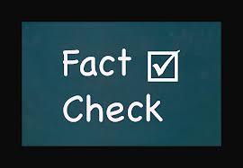
Myth #1: Rx Drugs are Safer than Illegal Drugs
Facts:
  Many Rx drugs can have powerful effects in the brain and body.
  They are safe for the person to whom they are prescribed (in the dosage prescribed by the doctor)
  Abusing Rx drugs and sharing them with friends is ILLEGAL.

Slide 16
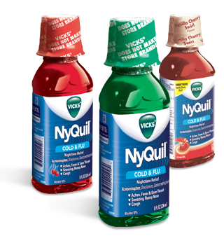
Myth #2: OTC Drugs are Safer
Fact: Cough and cold are some of the most commonly abused OTC meds.

Slide 17
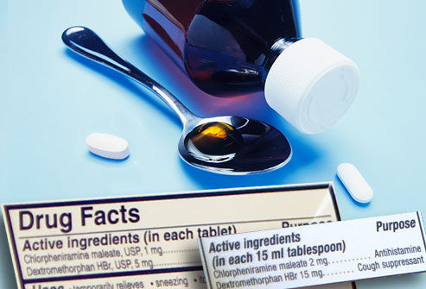
OTC – Cough and Cold Meds
Contain DXM – causes effects similar to PCP, a dissociative drug, which makes people feel disconnected from their normal selves.
Cough meds are safe when taken as directed, but when abused they are taken in large quantities to get the high.

Slide 18
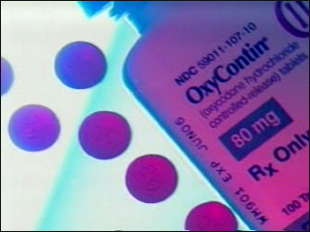
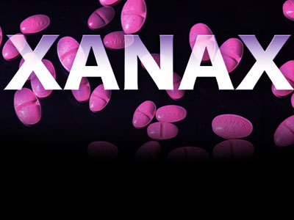
Most Commonly Abused Rx Drugs
Opioids
  Oxycontin
  Vicodin)
Stimulants
  Adderall
  Concerta
Central Nervous System Depressants
  Xanax
  Valium)

Slide 19
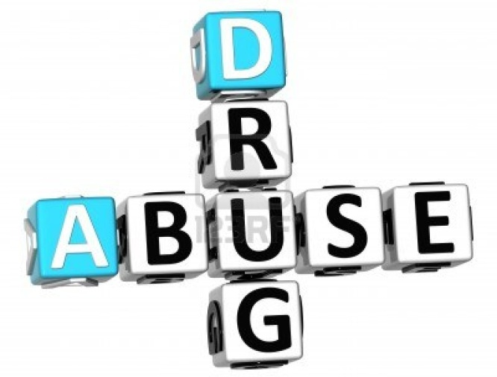
4 Issues with Abusing Rx Drugs

Slide 20
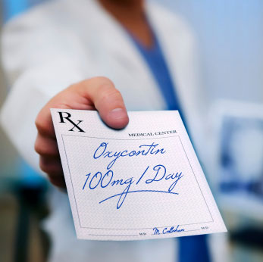
1. Personal data
Before prescribing meds, doctors take into account:
  a person's weight
  how long they've been prescribed the medication
  other medications they are taking

Slide 21
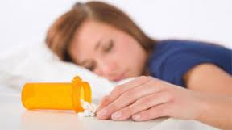
Personal Data – How it Applies to YOU
  Someone abusing prescription drugs may overload their system or make themselves vulnerable to dangerous drug interactions that can cause seizures, coma, or even death.

Slide 22

2. Form & Dose
Doctors know how long it takes for a pill or capsule to dissolve in the stomach, release drugs to the bloodstream, and reach the brain.

Slide 23
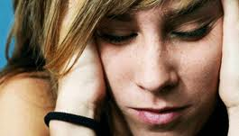
Form & Dose- How it Applies to YOU
When abused, prescription drugs may be taken in inappropriate doses or by routes of administration that change the way the drugs act in the body and brain, presenting overdose risk.

Slide 24
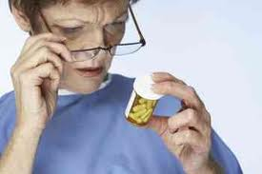
3. Side Effects
Prescription drugs are designed to treat a particular illness or condition, but they often have other effects on the body, some of which can be dangerous.

Slide 25
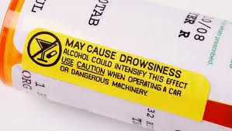
Side Effects – How it Applies to YOU
Side effects can be worse when prescription drugs are not taken as prescribed or are abused in combination with other substances—including alcohol, other prescription drugs, and even over-the-counter drugs, such as cold medicines.

Slide 26
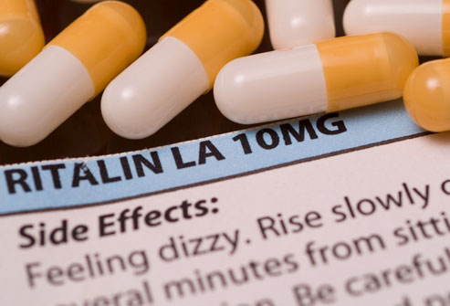
4. Addiction
When people take medication as it is prescribed for a medical condition—such as pain or attention deficit hyperactivity disorder (ADHD) they usually do not become addicted, because the medication is prescribed in dosages and forms that are considered safe for that person.
The person is also monitored by a physician.
The drug addresses a real problem, which makes the person feel better, not high.

Slide 27
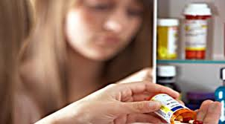
Addiction- How it Applies to YOU
Medications that affect the brain can change the way it functions—especially when they are taken repeatedly or in large doses.
They can alter the reward system, making it harder for a person to feel good without the drug and possibly leading to intense cravings, which make it hard to stop using.

Slide 28
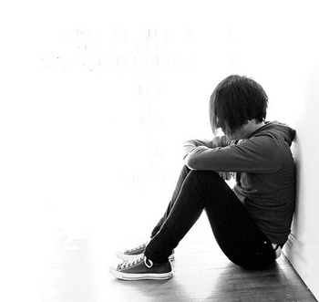
Short & Long Term Effects

Slide 29
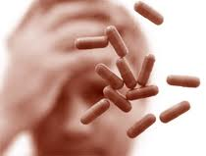
Short & Long Term Effects
Stimulant Abuse
  causes paranoia, dangerously high body temperatures, and an irregular heartbeat, especially if stimulants are taken in large doses or in ways other than swallowing a pill.

Slide 30
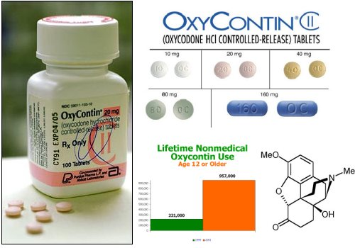
Short & Long Term Effects
Opioid Abuse
  Opioids cause drowsiness, nausea, constipation, and, depending on the amount taken, slowed breathing.

Slide 31
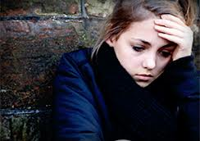
Short & Long Term Effects
Depressant Abuse:
  Causes slurred speech, shallow breathing, fatigue, disorientation, lack of coordination, and seizures (upon withdrawal from chronic abuse).

Slide 32
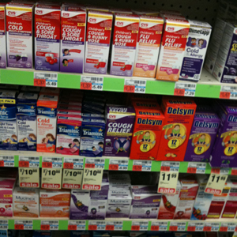
Short & Long Term Effects
OTC Drug Abuse:
  Over the counter drugs that contain DXM-which usually involves taking doses much bigger than recommended for treating coughs and colds – can impair motor function; produce numbness, nausea & vomiting; and increase heart rate and blood pressure.

Slide 33
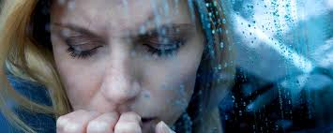
Short & Long Term Effects
Abusing any type of mind-altering drug can affect judgment and inhibition and may put a person at heightened risk for HIV and other sexually transmitted diseases (STDs).

Slide 34
How YOU Can Help
Get Involved:
  The Council on Alcohol and Drugs
  www.stoprxabuseinga.org
  Rx Drug Abuse/Misuse Initiatives in Early, Catoosa, and Gwinnett

Slide 35
Points of Contact
Department of Behavioral Health
  Latrina Patrick – lapatrick@dbhdd.ga.gov
  (404) 232-1582
The Council on Alcohol & Drugs
  John Bringuel – jbringuel@livedrugfree.org
  (404) 223-2484
  www.stoprxabuseinga.org

Slide 36
References/Resources
National Institute on Drug Abuse (NIDA); www.drugabuse.gov
  National Institute on Drug Abuse. Monitoring the Future. National Results on Adolescent Drug Use. Overview of Key Findings 2012 (http://monitoringthefuture.org).Bethesda, MD: NIDA, NIH, DHHS. Printed December 2012. Retrieved December 2012.
Substance Abuse and Mental Health Services Administration (SAMHSA); www.samhsa.gov
  Center for Behavioral Health Statistics and Quality; Results from the 2011 National Survey on Drug Use and Health: Summary of National Findings (http://www.samhsa.gov/data/NSDUH/2k11Results/NSDUHresults2011.htm).

